Slide 1

Variables, Objects, Methods, Conditionals

Slide 2
Upgrade Time!
New code for a newer Minecraft
Get on the WiFi
http://files.minecraftforge.net/
Latest 1.6.4 (* to skip AdFly)
http://github.com/FredXCoders/BaseMod
Download Zip
Extract forge somewhere (c:/dev/mc1.6.4) and run install.cmd

Slide 3
Share

Slide 4
Variables
What do they do?
Types:
  int
  boolean

Slide 5
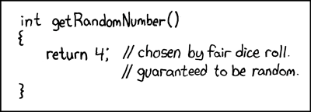
Objects
Random – how can we get a random number?
MyBlock
EntityPlayer
World
The value
Primatives vs Objects

Slide 6
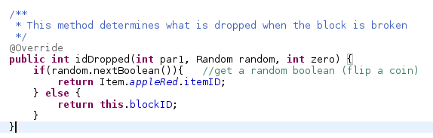
Methods
Variable return type
Method arguments
Method returns

Slide 7
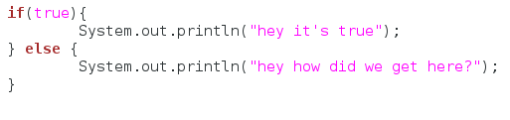
Conditionals
If something is true
then do this thing
else do this other thing

Slide 8
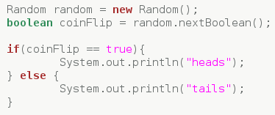
Conditionals

Slide 9
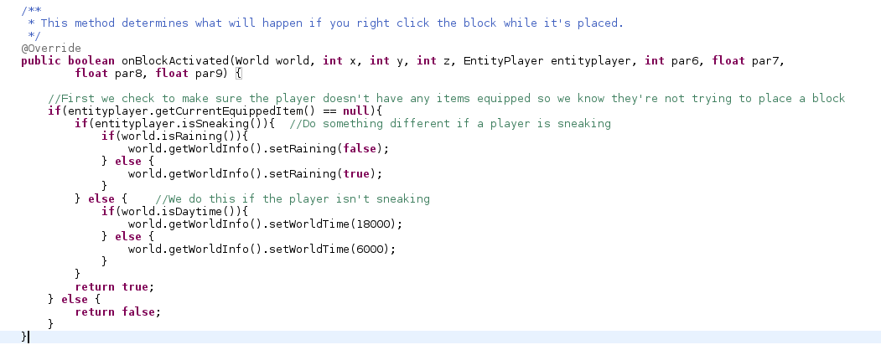
Conditionals

Slide 10


Boolean Logic

Slide 11
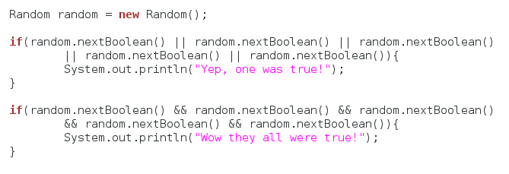
Conditional Operators
|| Or operator
&& And operator
== Equality operator
Short Circuiting

Slide 12
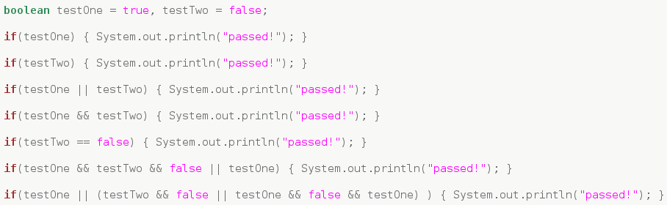
Boolean Logic Test

Slide 13
To the Code!
Go to your new forge folder and extract the downloaded BaseMod source into forge/mcp/src/minecraft
Fire up eclipse and switch to the workspace in your new forge/mcp/eclipse
Play around with the MyBlock:
  Change its properties
  Change its image
  Change what you get if you break it
  Change what happens when you click it

Slide 14
Create
Create your own NEW custom block
  Create the block class
  Pick out an image for you block
  Initialize your new block in BaseMod.java
  Add a recipe for your block

